Slide 1

ITA0502-COMPUTER VISION
U-Net and K-Means Clustering-Based MetalVision: Intelligent Metal Surface Color Segmentation Framework
M.Maruthi-192425257
Anvesh Chandra Reddy-192472303
Krishna Tejesh-192411200
A.Archishman-192425341
K.Subrahmanya Venkat sai-192472220
Program Director : Dr. Sasi Rekha, Prof / CSE Faculty : Mrs. R C Jeni Gracia, AP / CSE

Slide 2
Agenda
1
Introduction
7
Results and Discussion
2
Literature Review
8
Screenshots - Implementation
3
Problem Statement
9
Application
4
Objectives
10
Conclusion
5
System Architecture - Overall Design of Project
11
References
6
Modules - Techniques, Approaches & Methodologies

Slide 3
Introduction
Metal surfaces vary widely in color, texture, and finish across manufacturing batches.
Manual inspection of surface color/quality is slow, subjective, and error-prone.
MetalVision combines U-Net (deep learning segmentation) with K-Means clustering (unsupervised color grouping) to automate this process.
Goal: precise, consistent, and scalable color-based segmentation of metal surfaces for quality control.

Slide 4
Objectives
Design a U-Net based deep learning model for pixel-level segmentation of metal surfaces.
Apply K-Means clustering to group segmented regions by dominant color characteristics.
Build an integrated pipeline that combines segmentation accuracy with color-based grouping.
Evaluate the framework on real metal surface images for accuracy, consistency, and speed.

Slide 5
Problem Statement
Existing metal surface inspection methods struggle to consistently and accurately segment regions by color under varying lighting, surface finish, and material composition.
There is a need for an intelligent framework that combines deep learning-based segmentation with unsupervised color clustering to deliver accurate, consistent, and automated metal surface color segmentation for industrial quality inspection.

Slide 6
Literature Review
Author(s) & Year | Existing Technique | Advantages | Limitations
Ronneberger et al. (2015) | Original U-Net: encoder-decoder with skip connections | Precise pixel-level masks; works with limited training data | Built for medical images; needs domain adaptation
Lucchese & Mitra (1999) | K-Means clustering in the chromaticity color plane | Simple, fast, fully unsupervised | Sensitive to initial cluster centers & lighting
Pappas | Spatially-constrained K-Means generalization | Reduces noisy clusters via spatial continuity | Added compute cost; k still chosen manually
Xiao et al. | Weighted attention + U-Net residual (steel) | Eases gradient vanishing; better features | Weak on small, complex defects
SLMA U-Net (2025) | Spatial-channel attention U-Net for steel defects | Higher accuracy on steel/metal surfaces | More complex; costlier inference
Low-pass U-Net (2022) | Low-pass filter added before encoder downsampling | Captures high-frequency defect edges | Extra frequency-domain complexity
FDTransUnet (2024) | Transformer + U-Net for aluminum defects | High accuracy even with few samples | High training & compute cost
RGB-Histogram K-Means (2020) | Auto-selects cluster count from RGB histograms | No manual k needed; adaptive per image | Ignores learned spatial/semantic context

Slide 7
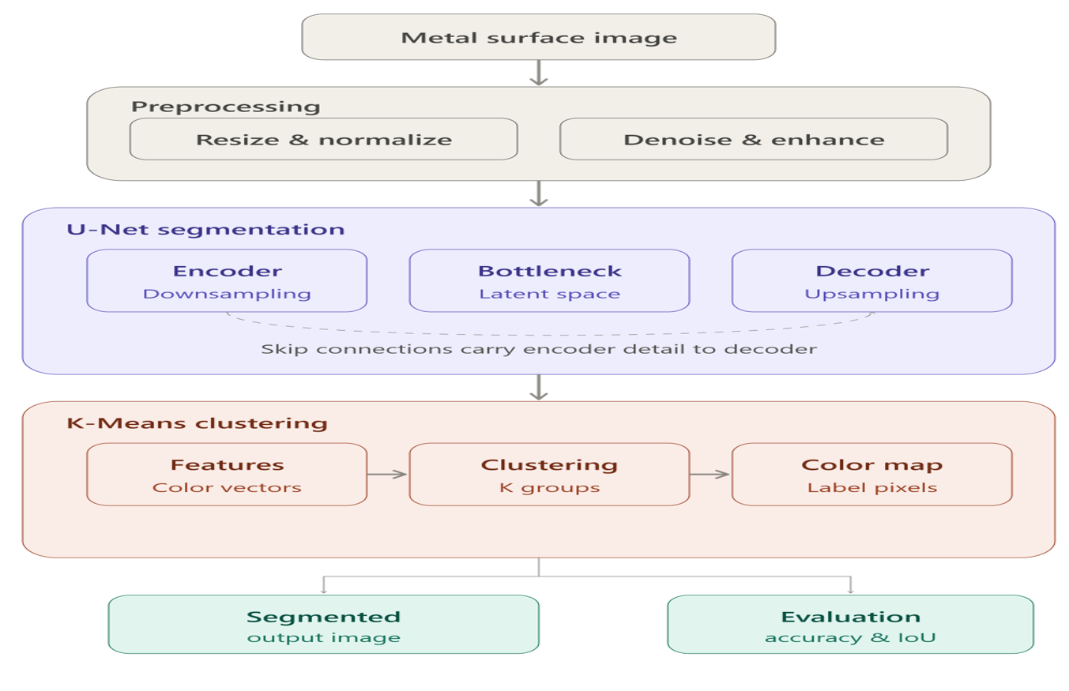
System Architecture

Slide 8
Modules
1. Image Acquisition & Preprocessing
2. U-Net Segmentation Module
Resize, denoise, and normalize the input metal surface image.
Encoder-decoder CNN with skip connections produces a pixel-level mask.
3. K-Means Clustering Module
4. Visualization & Evaluation Module
Groups segmented pixels into color clusters by similarity.
Overlays results and computes IoU, Dice, and accuracy metrics.

Slide 9
Module 1 : Preprocessing
Technique / Approach
Raw metal surface images are captured or imported from a dataset, then standardized before entering the network.
Resizing gives every image a fixed resolution so the network's input layer stays consistent.
Normalization rescales pixel intensities into a small numeric range so training converges faster.
A denoising filter (Gaussian or median) suppresses sensor noise and glare from the metal surface, and optional histogram equalization improves contrast on dull or unevenly lit samples.

Slide 10
Module 2 : U-Net Segmentation
Technique / Approach
U-Net is a convolutional encoder-decoder network.
The encoder repeatedly applies convolution, ReLU activation, and max-pooling to shrink the image spatially while extracting increasingly abstract features.
The bottleneck holds the deepest, most compressed feature representation.
The decoder then reverses this with up-convolutions, and at each stage concatenates the matching encoder feature map through a skip connection, so fine spatial detail lost during downsampling is recovered.
A final 1×1 convolution with a sigmoid/softmax activation outputs a per-pixel segmentation mask.

Slide 11
Module 3 : K-Means Clustering
Technique / Approach
Once regions are segmented, each pixel's color (RGB or Lab values) becomes a feature vector.
K-Means partitions these vectors into k groups so that pixels within a group share similar color, while pixels in different groups are dissimilar.
The number of clusters k can be fixed from domain knowledge or chosen with the elbow / silhouette method.
The algorithm alternates between assigning pixels to the nearest centroid and recomputing centroids, until the assignments stop changing.

Slide 12
Module 4 : Visualization & Evaluation
Technique / Approach
The predicted segmentation mask and K-Means color clusters are overlaid on the original metal surface image so results can be inspected visually.
In parallel, quantitative metrics compare the prediction against ground-truth labels (where available):
Intersection-over-Union and Dice coefficient measure mask overlap quality, while pixel accuracy measures the overall fraction of correctly classified pixels.
These scores feed directly into the Results & Discussion analysis.

Slide 13
Results and Discussion
Combining U-Net with K-Means is expected to outperform either technique alone.
U-Net contributes precise, learned region boundaries.
K-Means adds consistent, interpretable color grouping on top of those regions.
Traditional thresholding and plain K-Means struggle most under variable lighting.
Deeper attention-based U-Net variants(Module 2) should further close the gap.
Illustrative values based on reported trends in the literature; to be replaced with measured results.
13

Slide 14
Application
Steel Manufacturing QC
Automotive Body Panels
Automated color/finish inspection on production lines
Detecting paint or coating inconsistencies
Aerospace Components
Coating & Plating Verification
Surface uniformity checks on critical metal parts
Confirming uniform coverage of protective coatings
Scrap Metal Sorting
Corrosion & Rust Monitoring
Grading recycled metal by surface color/condition
Tracking oxidation on infrastructure over time

Slide 15
Conclusion
Metal surface color inspection remains largely manual, slow, and inconsistent across industries.
MetalVision addresses this by pairing U-Net's precise pixel-level segmentation with K-Means' unsupervised color grouping.
The combined pipeline is designed to be more accurate and consistent than either technique used alone.
Expected outcomes include faster inspection cycles, reduced human error, and scalable deployment across production lines.
Future work: expand to attention-based U-Net variants, adaptive cluster selection, and real-time deployment on edge devices.

Slide 16
References
[1] O. Ronneberger, P. Fischer, and T. Brox, “U-Net: Convolutional Networks for Biomedical Image Segmentation,” MICCAI, 2015.
[2] L. Lucchese and S. K. Mitra, “Unsupervised segmentation of color images based on k-means clustering in the chromaticity plane,” IEEE CBAIVL, 1999.
[3] T. N. Pappas, “An adaptive clustering algorithm for image segmentation,” IEEE Transactions on Signal Processing.
[4] Xiao et al., “Steel surface defect segmentation using a weighted-attention U-Net with residual connections.”
[5] “SLMA-U-Net: Spatial-Channel Gray-Level Mixed Attention U-Net for steel surface defect segmentation,” 2025.

